Slide 1
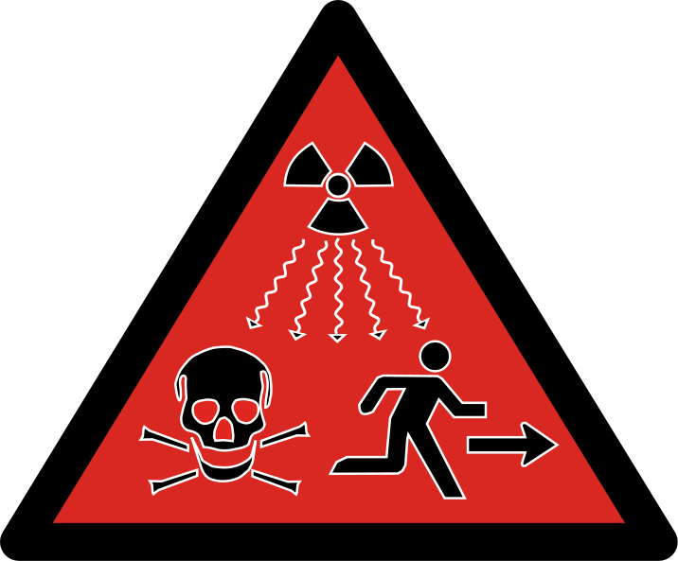
Radiation Physics

Slide 2
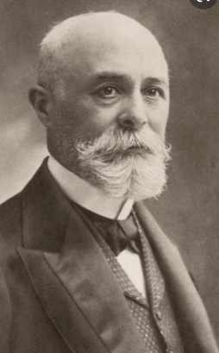
Radioactivity History
In 1896, Becquerel accidentally discovered that uranyl potassium sulfate crystals emit an invisible radiation.
This radiation can darken a photographic plate even though the plate is covered to exclude light.

Slide 3
Radioactivity History
After a series of experiments,
he concluded that the radiation emitted by the crystals was of a new type, one that requires no external stimulation and was so penetrating that it could darken protected photographic plates and ionize gases.
This process of spontaneous emission of radiation by uranium was soon to be called radioactivity.

Slide 4

Radioactivity History
Subsequent experiments by other scientists showed that other substances were more powerfully radioactive.
The most significant early investigations of this type were conducted by Marie and Pierre Curie (1859–1906).

Slide 5
Radioactivity History
After several years of careful and laborious, Curies reported the discovery of two previously unknown elements, both radioactive, named polonium and radium.

Slide 6
Radioactivity History
Additional experiments, including Rutherford’s famous work on alpha-particle scattering, suggested that
radioactivity is the result of the decay, or disintegration, of unstable nuclei.

Slide 7
Nucleus
An atom is electrically neutral.
It contains an equal number of positively charged protons and negatively charged electrons and their charges balance.
The nucleus however contains only positively charged protons which are closely packed together in a very small volume

Slide 8
Nucleus
Protons and neutrons, collectively called nucleons, are packed together tightly in a nucleus.
With a radius of about 10⁻¹⁵ meters, a nucleus is quite small compared to the radius of the entire atom, which is about 10⁻¹⁰ meters.

Slide 9
Nucleus
Nuclei are extremely dense compared to bulk matter, averaging 1.8 × 10¹⁴ (g/cm³)grams per cubic centimeter.
If the earth’s density were equal to the average nuclear density, the earth’s radius would be only about 200 meters.

Slide 10
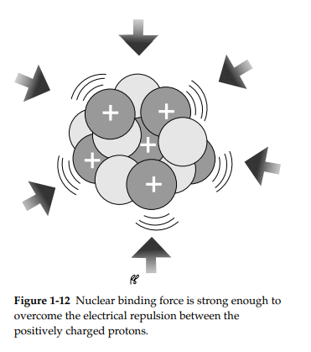
Strong Nuclear Force
A strong force must exist between the protons and neutrons in a nucleus to overcome the electrostatic repulsion between the protons.
This additional force is called the strong nuclear force.
This force is attractive over short distances

Slide 11
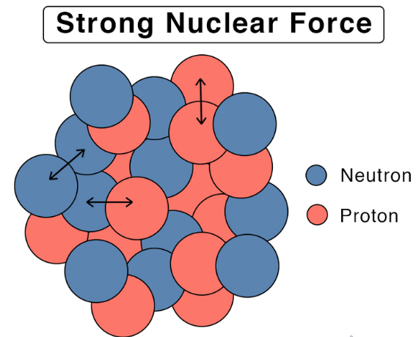
Strong Nuclear Force
To hold positively charged protons together in the very small volume of a nucleus requires very strong attractive forces
because the positively charged protons repel one another strongly at such short distances.
The force of attraction that holds the nucleus together is the strong nuclear force.
This force acts between protons, between neutrons, and between protons and neutrons.

Slide 12
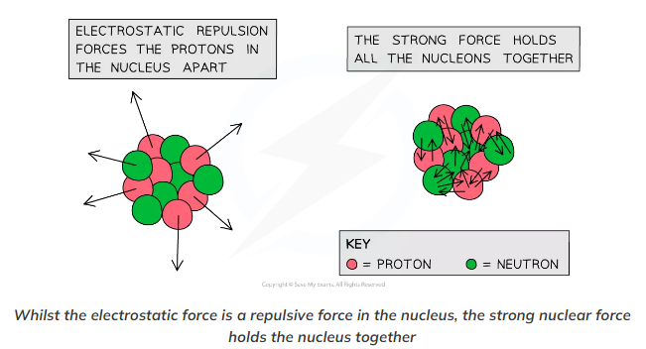
Strong Nuclear Force
It is very different from the electrostatic force that holds negatively charged electrons around a positively charged nucleus.
Over distances less than 10⁻¹⁵ meters and within the nucleus, the strong nuclear force is much stronger than electrostatic repulsions between protons;
over larger distances and outside the nucleus, it is essentially nonexistent.

Slide 13
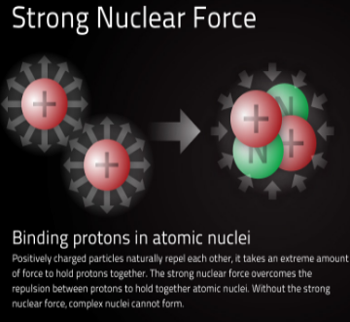
Binding Energy
Strong nuclear force must be repulsive at a very small range as well as being attractive over a slightly larger distance.
This is the force that holds the nucleus together and the energy associated with this force is called the binding energy.
It is the amount of strong nuclear force and the associated binding energy in a nucleus that determines whether it will be stable or unstable.

Slide 14
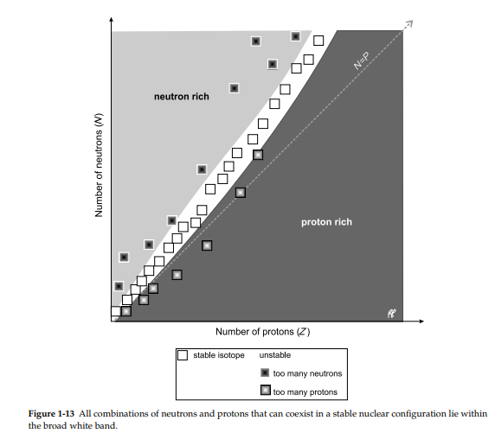

Slide 15
Stable Nuclei
A stable atom is an atom that has enough binding energy to hold the nucleus together permanently.
Many nuclei in nature are very stable, most of the nuclei formed at the creation of the universe or after supernovae explosions many millions of years ago are still in existence now.
The graph is a plot of neutron number against proton number.
It is used as rule to determine which nuclei are stable or unstable.

Slide 16
Stable Nuclei
Nuclei which lie on the stability line are stable nuclei.
From the plot it can be seen that many of the stable nuclei have equal number of protons and neutrons. These are usually the elements in the lighter section of the periodic table.
For the heavier stable nuclei the there are approximately 50% more neutrons to protons.

Slide 17
Stable Nuclei
A plot of the number of neutrons versus the number of protons for stable nuclei reveals that the stable isotopes fall into a narrow band.
This region is known as the band of stability (also called the belt, zone, or valley of stability).
The straight line in Figure 1 represents nuclei that have a 1:1 ratio of protons to neutrons (n:p ratio).
Note that the lighter stable nuclei, in general, have equal numbers of protons and neutrons.

Slide 18
Stable Nuclei
For example, nitrogen-14 has seven protons and seven neutrons.
Heavier stable nuclei, however, have increasingly more neutrons than protons.
For example: the stable nuclide iron-56 has 30 neutrons and 26 protons, an n:p ratio of 1.15, whereas the stable nuclide lead-207 has 125 neutrons and 82 protons, an n:p ratio equal to 1.52.
This is because larger nuclei have more proton–proton repulsions and require larger numbers of neutrons to provide compensating strong forces to overcome these electrostatic repulsions and hold the nucleus together.

Slide 19
Unstable Nuclei
In unstable nuclei the strong nuclear forces do not generate enough binding energy to hold the nucleus together permanently.
It is unstable nuclei that are radioactive and are referred to as radioactive nuclei and in the case of their isotopes called radioisotopes.
The unstable nuclei lie above and below the line of stability in the neutron – proton plot.
This gives information of the type of radioactive decay they will undergo.

Slide 20
Unstable Nuclei
Nuclei which lie above the line of stability contain too many neutrons to be stable.
They are referred to as “neutron rich”.
Those that lie below the line of stability contain too many protons to be stable and are called “proton rich”.

Slide 21
Unstable Nuclei
In summary it is the balance of protons and neutrons in a nucleus which determines whether a nucleus will be stable or unstable.
Too many neutrons or protons upset this balance disrupting the binding energy from the strong nuclear forces making the nucleus unstable.
An unstable nucleus tries to achieve a balanced state by given off a neutron or proton and this is done via radioactive decay.

Slide 22
Stable and Unstable
The nuclei outside the band of stability are unstable and exhibit radioactivity: they change spontaneously, or decay, into other nuclei that are either in or closer to the band of stability.
These nuclear decay reactions convert one unstable nuclide, or radionuclide, into another nuclide, which is often more stable.

Slide 23
Stable and Unstable
Nuclei with even numbers of protons, neutrons, or both are more likely to be stable.
Nuclei with certain numbers of nucleons, known as magic numbers, are stable against nuclear decay.
These numbers of protons or neutrons (2, 8, 20, 28, 50, 82, and 126) make complete shells in the nucleus.
These are similar in concept to the stable electron shells observed for the noble gases.
Nuclei that have magic numbers of both protons and neutrons are called “doubly magic” and are particularly stable.

Slide 24
Stable and Unstable
Nuclei with atomic numbers higher than 82 are radioactive.
Bismuth-209, atomic number 83, was thought to be stable for a very long time and can be handled as though it was non-radioactive.

Slide 25
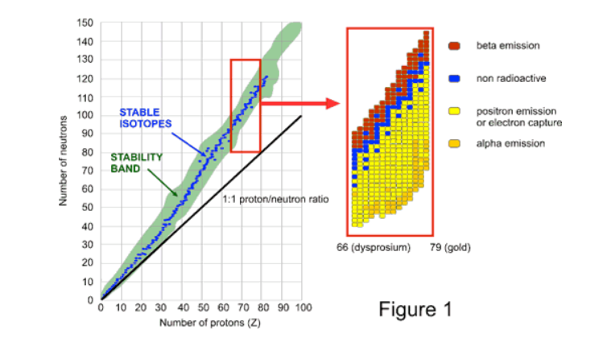

Slide 26
Radioactivity
Radioactivity is the property of some unstable atoms (radionuclides) to spontaneously emit nuclear radiation, usually alpha particles or beta particles often accompanied by gamma-rays.
This radiation is emitted when the nucleus undergoes radioactive decay and is converted into a different isotope which may, according to its number of neutrons and protons, be either radioactive (unstable) or non-radioactive (stable).
This “daughter” nucleus will usually be of a different chemical element to the original isotope

Slide 27
What causes atoms to be radioactive?
Atoms found in nature are either stable or unstable. An atom is stable if the forces among the particles that makeup the nucleus are balanced.
An atom is unstable (radioactive) if these forces are unbalanced; if the nucleus has an excess of internal energy.
Instability of an atom's nucleus may result from an excess of either neutrons or protons.
A radioactive atom will attempt to reach stability by ejecting nucleons (protons or neutrons), as well as other particles, or by releasing energy in other forms.

Slide 28
What causes atoms to be radioactive?
The band of nuclear stability (Figure 1) indicates various neutron/proton combinations that give rise to observable nuclei with measurable half-lives.
A close-up look at the band of nuclear stability in the region from Z = 66 (dysprosium) through Z = 79 (gold) shows the types of radioactive processes undergone by various nuclides.
Nuclides with lower neutron/proton ratios tend to undergo positron emission, electron capture, or alpha emission, whereas nuclides with higher neutron/proton ratios tend to undergo beta emission.

Slide 29
What happens to atoms after they release radiation?
As the nucleus emits radiation or disintegrates, the radioactive atom (radionuclide) transforms to a different nuclide.
This process is called radioactive decay.

Slide 30
What happens to atoms after they release radiation?
It will continue until the forces in the nucleus are balanced.
For example, as a radionuclide decays, it will become a different isotope of the same element if it gives off neutrons or a different element altogether if it gives off protons.
The series of transformations that a radionuclide goes through to reach stability and the type of radiation produced is characteristic of the radionuclide.
The stages form a decay series.

